Slide 1
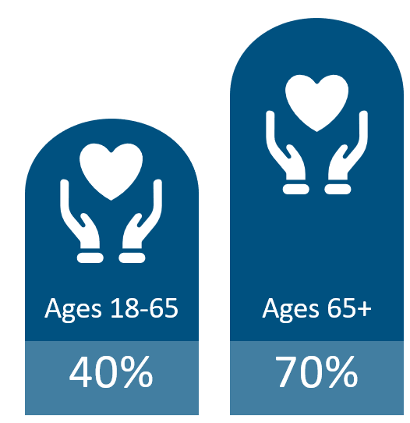
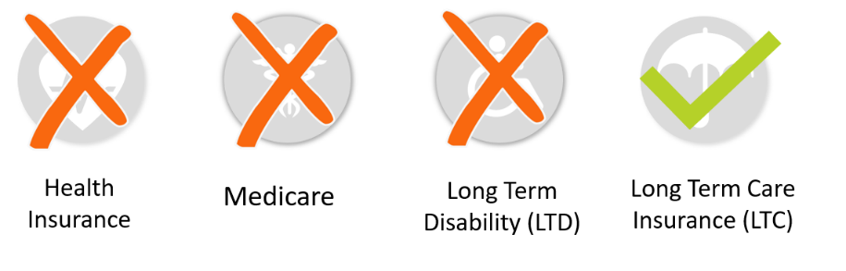
Long Term Care Insurance
Likelihood of Requiring LTC¹
Benefits That Cover Long Term Care
¹ASPE.HHS.gov, 2019
Top 3 Reasons Consumers Give for Considering a Life + LTC Product*
Concern that long-term care costs may deplete or exceed my savings – 35% It is a more economical use of my current assets – 33% 3. Benefits will be paid even if I don’t incur long-term care expenses – 29%
A 2021 LIMRA Study* found more than 6 in 10 Americans would consider a Life combination product.

Slide 2
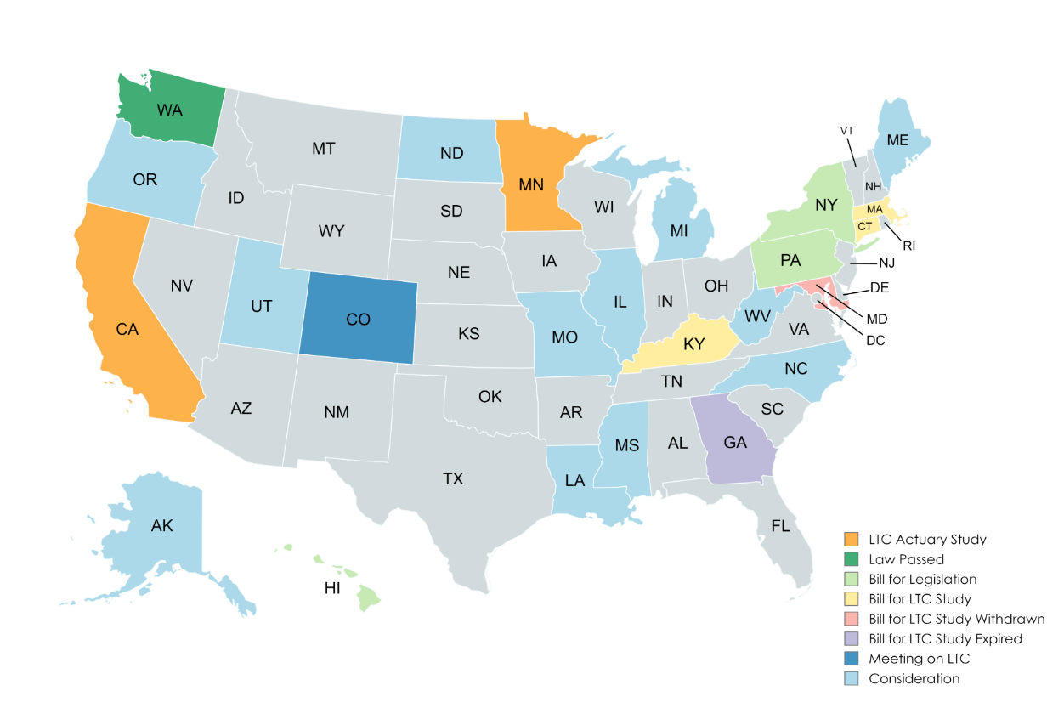
Long Term Care State Legislation
Medicaid is the primary payor for LTC in the United States. States are evaluating options to help reduce their state Medicaid cost.
H.R. 8820 - Improving Access to Long-Term Care Insurance Act bill.
Proposing an above-the-line tax deduction for premiums paid on LTC insurance in an effort to make LTC insurance more accessible and affordable.

Slide 3

Long Term Care Insurance
Advantages of Group Life + LTC
Illustrative Plan Design and Premiums
Guarantee Issue – no health questions asked during initial enrollment.
Issue Age Rates – based on age when policy is issued. Rates do not increase with age.
Portable Benefit – employees can take coverage with them at the same rates.
Benefit Features | Voluntary Plan Design | Employer-Funded Minimum Plan Design
Life Insurance Benefit | $50,000 | $10,000
LTC Monthly Benefit | $2,000 | $400
LTC Max Benefit | $100,000 | $20,000
Monthly Premium | 40-year-old $30 - $60 | Per Employee $5 - $30

Slide 4

Employer LTC Benefit Strategies
New York Life
KFF
Formerly Known as the Kaiser Family Foundation
Buck Consulting
Gallagher
The top five benefits employees are most interested in receiving: Employer match on a 401(k) or other retirement savings plan (74%), Supplemental health insurance (50%), Flexible work arrangements (48%), Mental health support/access to resources (38%) and Long-term care insurance (37%).
Currently about 25% of employers offer LTCi, recent survey data shows that 66% of employers plan to do something with respect to Long-Term Care and will look at it in the coming year.
25% of employers offering health benefits also offer LTC insurance. Of those employers offering LTC insurance, 39% contribute toward the cost of the plan through employer-funding.
In 2022, 16% of employers surveyed were interested in offering LTC insurance.
That number increased to 28% in 2023.
Group Benefit Solution
Independent Source for Health Policy Research, Polling and News
2023 Benefits Strategy & Benchmarking Survey
© 2024
www.LTC-Solutions.com
Notes:
Employers are increasingly recognizing the importance of adding Long-Term Care (LTC) insurance as part of their employee benefit packages. Several recent benchmarking studies highlight this trend and provide insights into how LTC benefits are being integrated into broader employee benefits strategies.
Increasing Adoption: According to the 2024 MetLife Employee Benefit Trends Study, there is a growing emphasis on comprehensive benefits that address the diverse needs of employees. Employers are adding LTC insurance to their offerings to enhance employee well-being and support long-term financial security. This move aligns with a broader trend of employers seeking to provide holistic benefits that improve employee satisfaction and retention.
Employee Satisfaction and Engagement: The same MetLife study indicates that employees who are satisfied with their benefits are 1.6 times more likely to be productive and 1.5 times more likely to be engaged and loyal. This highlights the importance of offering benefits, such as LTC insurance, that resonate with employees' needs and contribute to their overall well-being.
By incorporating LTC insurance, employers not only provide a valuable financial safety net for their employees but also enhance their overall benefits offering, which can lead to improved employee satisfaction, engagement, and retention.

