Slide 1
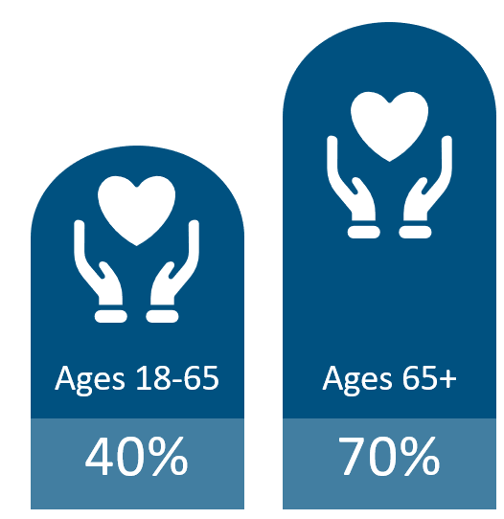





Long Term Care Insurance
Likelihood of Requiring LTC¹
Average Cost of Care²
Home Care
Assisted Living
Nursing Home
$77,792
Avg Stay 3 years
$70,800
Avg. Stay 2.5 years
$127,750
Avg. Stay 2.4 years
Benefits That Cover Long Term Care
LTC Financing Crisis
56% of couples without LTC insurance spend their income down to poverty level after one partner has spent six months in a nursing home³ Medicaid now consumes 30% of state budgets Medicaid pays for about 45% of total LTC service and support costs⁴
¹ASPE.HHS.gov, 2019 ²Genworth 2024 Cost of Care ³ Health Insurance Association of America ⁴ Long-Term Services and Supports: History of Federal Policies and Programs, Congressional Research Service, December 2023.

Slide 2








Why Employers Offer LTC Insurance
LTC LEGISLATION
EMPLOYERS OFFERING LTC BENEFITS
  In 2023, the US Medicaid budget was $536B ▪ Cost associated to LTC equated to $164B (31%) of the budget ▪ Numbers like these largely drove the establishment of the WA Cares Fund
  KFF – 25% of employers offering health insurance also offer LTC insurance. Of those, 39% contribute toward the cost of the plan through employer funding
  Long-Term Care was identified as the fastest growing voluntary benefit from 2020 to 2024 - BenefitsPRO
401K/403B PRESERVATION
401k
Social Security
  Prevent employees from leaning disproportionately on 401k
Personal Savings
LTC Benefits
EMPLOYER FUNDING
State Programs/
Medicaid
  Funded for All or Defined Class – years of service, title, salary
  Attract & Retain – with differentiating benefit
  401k/403b Preservation – employees that max out benefit
  Employee Engagement – increases 600%
SANDWICH GENERATION OF EMPLOYEES
  By 2030, all baby boomers will be age 65 or older according to the US Census Bureau
EMPLOYEES REQUESTING LTC
GROUP PLAN ADVANTAGES
2021 LIMRA Study - top 3 reasons for Life + LTC products:
  Concern LTC costs may deplete or exceed savings – 35%
  It is a more economical use of current assets – 33%
  Benefits pay even if LTC expenses aren’t incurred – 29%
NY Life Study
  LTC is one of top 5 benefits employees are most interested in
  Portable – at same rate
  Issue Age Rates – do not increase with age
  Guaranteed Issue – exclusive to employer plans. Provides employees access to a benefit.
  Gender Neutral Rates – same rates regardless of gender

Slide 3
Off-Cycle Enrollment
600% engagement increase compared to on-cycle
Proposal | August | September | October
Client Decision | August | September | October
Enrollment Month | October | November | November (funded)
Effective Date | 12/1/25 | 1/1/26 | 1/1/26
New York Life

