Slide 1
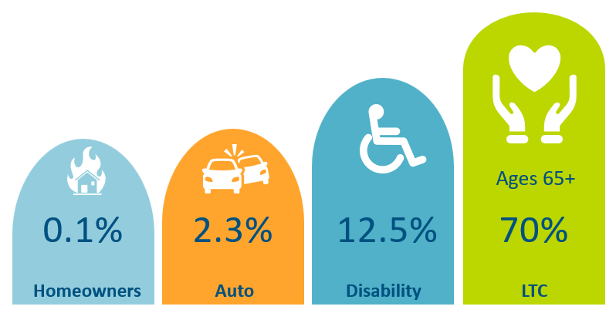




Long-Term Care Insurance
Likelihood of Requiring LTC¹
Average Cost of Care²
Home Care
Assisted Living
Nursing Home
$80,080
Avg Stay 3 years
$74,400
Avg. Stay 2.5 years
$129,575
Avg. Stay 2.4 years
Benefits That Cover Long Term Care
LTC Financing Crisis
56% of couples without LTC insurance spend their income down to poverty level after one partner has spent six months in a nursing home³ Medicaid now consumes 30% of state budgets Medicaid pays for about 45% of total LTC service and support costs⁴
¹ASPE.HHS.gov, 2019 ²Genworth 2025 Cost of Care ³ Health Insurance Association of America ⁴ Long-Term Services and Supports: History of Federal Policies and Programs, Congressional Research Service, December 2023.

Slide 2

Reasons Employers Offer an LTC Benefit with LTC Solutions
GROUP PLAN ADVANTAGES
401k / 403b PRESERVATION
  Portable – at same rate
  Issue Age Rates – do not increase with age. Cost of Waiting
  Guaranteed Issue – Provides employees access to a benefit. Individual App & Declinations
  Return on investment with LTC Insurance is greater than self-insuring
  Self-Investing Calculator
EMPLOYER-FUNDING
LTC LEGISLATION
  401k/403b preservation – For those that max out their benefit and a better ROI for the employer’s dollars.
  All employees – better ROI funding an LTC benefit
  Funded for All or Defined Class – years of service, title, salary
  US Medicaid budget - $536B in 2023 with LTC making up 31%
  States’ Medicaid budget is ~ 30% and continues to grow
  Christine McCullugh – national expert on LTC legislative activity. Keeps broker partners updated on must recent activity.
  Legislative Heatmap
LTCS CARE NAVIGATION BENEFIT
  Provided to all employees & family members
  Can replace or be an extension of an eldercare EAP program
© 2026
www.LTC-Solutions.com

Slide 3
Off-Cycle Enrollment
Proposal | July | August | September
Client Decision | August | September | October
Enrollment Month | October | November | December
Effective Date | 12/1/26 | 1/1/27 | 2/1/27
New York Life

